Slide 1
FYP5: Object Detection, Tracking and Suspicious Activity Recognition for Maritime Surveillance using Thermal Vision

Slide 2
Weekly Tasks
Training on CornerNet-Lite
TRN Evaluation
Network Pipeline

Slide 3
CornerNet-Lite
Main Objective: To make the CornerNet more efficient.
Two orthogonal ways adopted to do this:
1. Reducing the number of pixels to process (through downsampling and region cropping) - ConerNet-Saccade
2. Reducing number of processing per pixel (through reducing the complexity of backcorne) – CornerNet-Squeeze
Model | Backborne | Inference time per frame*
CornerNet-Saccade | Hourglass-54 | 850ms
CornerNet-Squeeze | Squeezed hourglass | 172ms
CenterNet | Hourglass-104 | 500ms

Slide 4
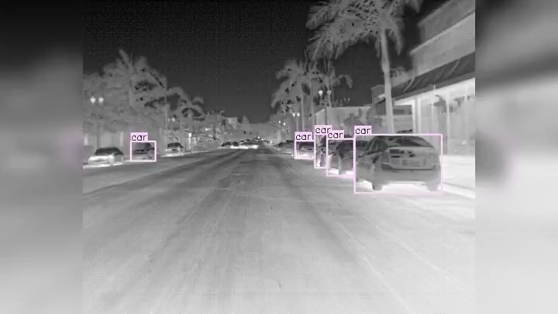
CornerNet-Lite outputs
CornerNet – Lite Squeeze
CornerNet – Lite Saccade

Slide 5
TRN
After 31 epochs: {'AP': {'BaseballPitch': 0.0011485394304375039, 'BasketballDunk': 0.015182175501360551, 'Billiards': 0.024213936285735694, 'CleanAndJerk': 0.021841990851971638, 'CliffDiving': nan, 'CricketBowling': 0.003112416042829555, 'CricketShot': 0.003282976152605099, 'Diving': 0.01745723973791102, 'FrisbeeCatch': 0.0030867960323933286, 'GolfSwing': 0.03669336676475077, 'HammerThrow': 0.015559729343623428, 'HighJump': 0.08140757382725047, 'JavelinThrow': 0.03995859383989032, 'LongJump': 0.0032073298759782353, 'PoleVault': 0.054573524264373556, 'Shotput': 0.00439902215431662, 'SoccerPenalty': 0.029895324935564134, 'TennisSwing': 0.008530727314986957, 'ThrowDiscus': 0.011179631022249111, 'VolleyballSpiking': 0.009571956574566255}, 'mAP': nan}
After 36 epochs: {'AP': {'BaseballPitch': 0.003376647213237524, 'BasketballDunk': 0.01421458942555338, 'Billiards': 0.034446983739229074, 'CleanAndJerk': 0.020296302864876173, 'CliffDiving': nan, 'CricketBowling': 0.002484955570492046, 'CricketShot': 0.0034644961910992207, 'Diving': 0.01562317220843709, 'FrisbeeCatch': 0.004501569447994208, 'GolfSwing': 0.021495826428424732, 'HammerThrow': 0.014160064053841223, 'HighJump': 0.08874542676428801, 'JavelinThrow': 0.0617857880003488, 'LongJump': 0.0029780367013701277, 'PoleVault': 0.05564666149141251, 'Shotput': 0.003449240408102525, 'SoccerPenalty': 0.028135254783956565, 'TennisSwing': 0.010829832314147903, 'ThrowDiscus': 0.01190374196124588, 'VolleyballSpiking': 0.009112429834364902}, 'mAP': nan}

Slide 6
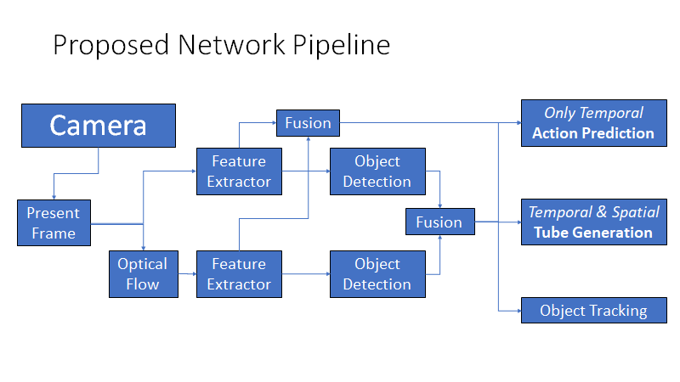
Pipeline
Farneback: 0.5 s
CPU
CornerNet: 0.6 s
CornerNetLite: 0.2s
GPU
TRN: 0.04 s
GPU

Slide 7
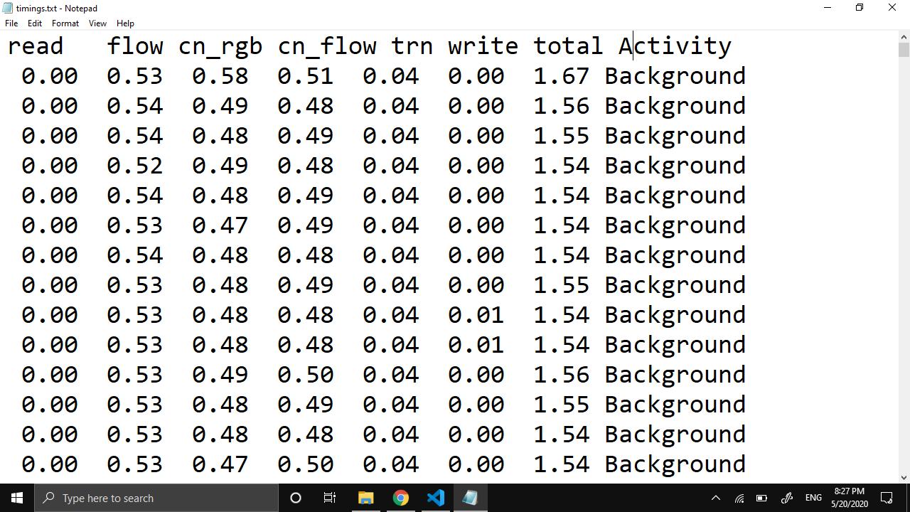

Slide 8
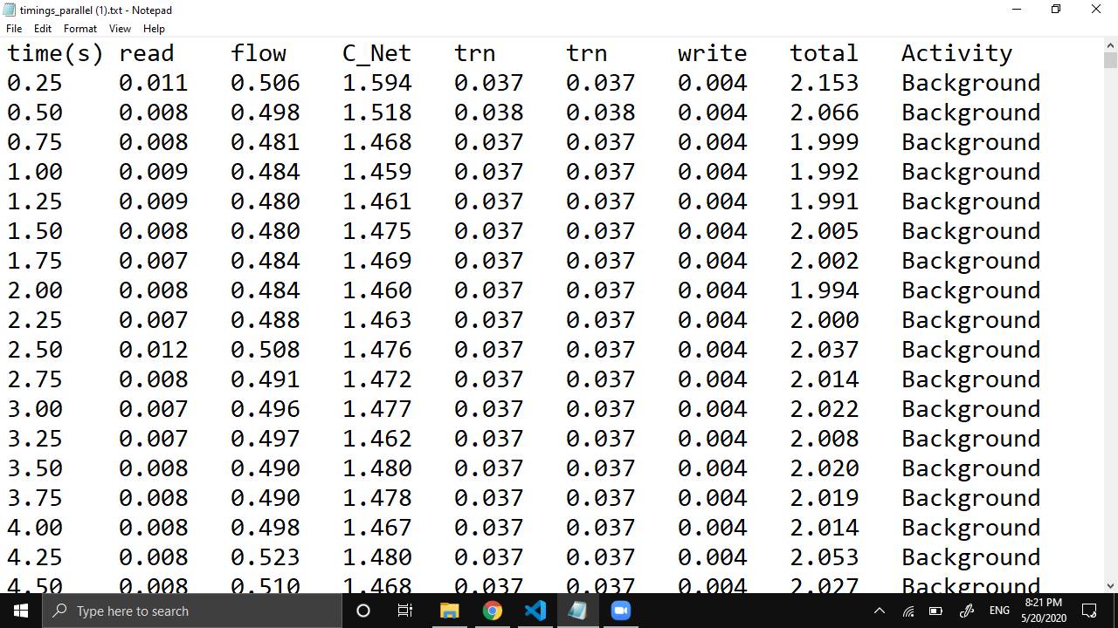

Slide 9
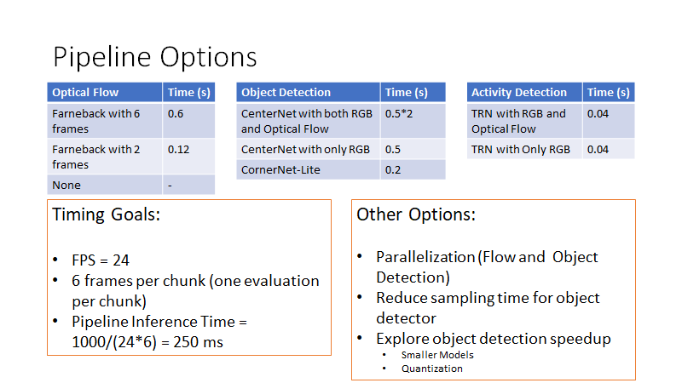

Slide 10
Comparison of Hardware
A comparison of Gyros, Micro Controllers, Servo Motors and Platform Designs

Slide 11
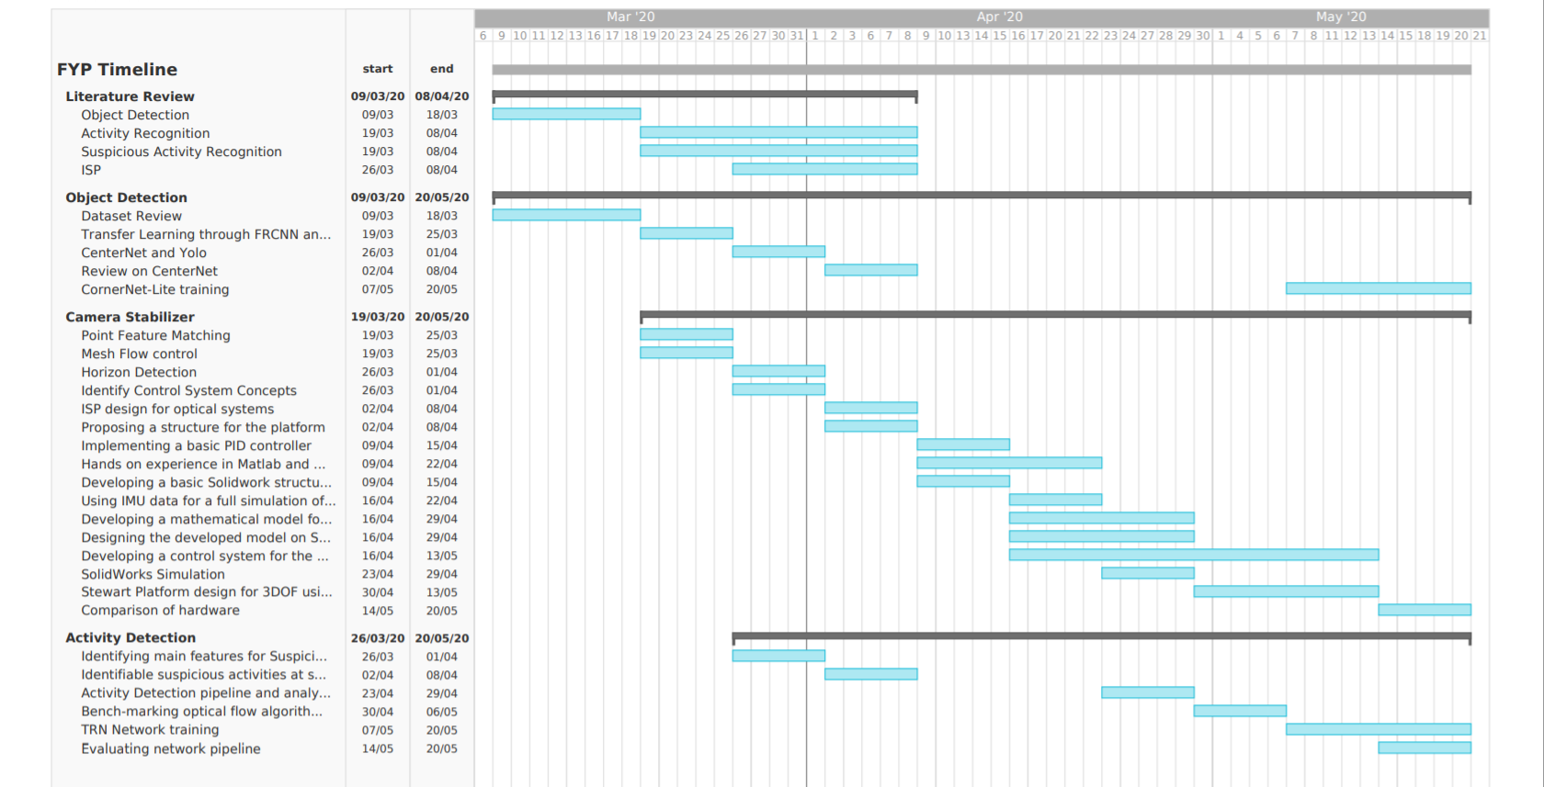

Slide 12

Tasks for next week
TRN network training.
CornerNet-Lite training
Try to simulate control system with online arduino based simulator Tinkercad

